Slide 1

User & Group Management
CSC 235 Introduction to Linux, Linux Admin & Mgmt
Instructor, Joel C. Nonnweiler
Email: jnonnweiler@stmartin.edu

Slide 2
Agenda
Users and Groups Overview [7.1]
User Management [7.2]
Group Management [7.3]
Troubleshoot User Issues [7.2]
Common Permission Problems [7.4]

Slide 3
User and Group Overview
User and Group Types
User and Group Databases
Managing Password File Entries

Slide 4
Key Terms/Definitions
Standard user
System or service user
Primary group
Secondary group
Shadow file
A user account that can log in to the system.
An account that's created by default during the Linux installation and used by the system for specific roles.
A group created by default on most Linux distributions when a standard user is created (also called a private group). They're used to manage access to files and directories.
A group type that manages access to files and directories, similar to a primary group. Users often belong to multiple secondary groups.
A file (such as the /etc/shadow file) that holds passwords and password expiration information for user accounts. The /etc/gshadow file holds passwords for groups.

Slide 5
Key Terms/Definitions
A group created by default on most Linux distributions when a standard user is created (also called a private group). They're used to manage access to files and directories.
Standard User
System or Service User
Primary Group
Secondary Group
An account that's created by default during the Linux installation and used by the system for specific roles.
A group type that manages access to files and directories, similar to a primary group. Users often belong to multiple secondary groups.
A user account that can log in to the system.

Slide 6
User Account and Group Information
User Account Types
Standard User UID (starting at) 1000
Superuser “root” UID 0
System Account (e.g., Apache web server) 2-digit UID
Service Account (e.g., SQL server database) 3-digit UID
Group Types
Primary Group “private group” / tied to the Standard User
Secondary Group membership assigned by sysadmin

Slide 7
Key Terms/Definitions
This file holds user account information. It contains the following fields:
User account name
Password
x - indicates that passwords are stored in the /etc/shadow file
User ID number (UID)
Primary group ID number (GID)
Description field (this field is typically used for the user's full name)
Path to the home directory
Path to the default shell
/etc/passwd
/etc/shadow
This file holds password hashes and password expiration information for user accounts. It contains the following fields:
User account name
Password hash
$ - preceding the password identifies the password as an encrypted entry
! or !! - indicates that the account is locked and can't be used to log in
* - indicates a system account entry and can't be used to log in
Last change (*number of days since January 1, 1970)
Minimum password age (min number of days before changing the password)
Maximum password age (max number of days between password changes)
Password change warning (number of days before mandatory change)
Grace logins (number of days log-in allowed after mandatory change)
Disable time (*number of days since January 1, 1970)

Slide 8
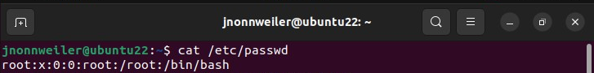
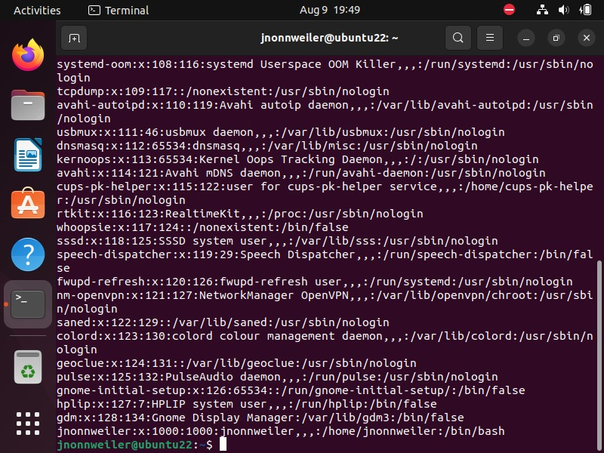
Locally Stored User Account Information
/etc/passwd
User account name
Password (an "x" in the field indicates that passwords are stored in the /etc/shadow file)
User ID number (UID)
Primary group ID number (GID)
Description field (this field is typically used for the user's full name)
Path to the home directory
Path to the default shell
password
UID
GID
account name
description
path to home
path to shell

Slide 9
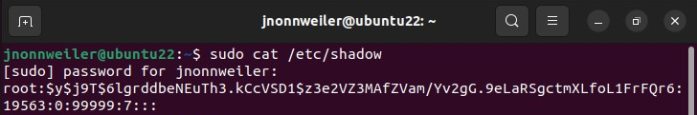
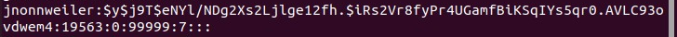
Locally Stored User Account Information
/etc/shadow → holds the password hashes and password expiration for user accounts
User account name
Password hash
Last change
Min password age
Max password age
Password change warning
Grace logins
Disable time
Password Hash
(char preceding the hash)
$ the password is encrypted
! or !! account is locked
* system account, can’t be used to log in

Slide 10
Key Terms/Definitions
/etc/group
/etc/gshadow
This file holds password hashes for groups. It contains the following fields:
Group name
Group password
! - the group account can't be accessed with the password
!! - no password has been assigned to the group account
No value - only group members can log in to the group account
Administrators
Group members
This file holds group and group membership information. It contains the following fields:
Group name
Group password
x - indicates the group passwords are contained in the /etc/gshadow file
Group ID
Group members

Slide 11
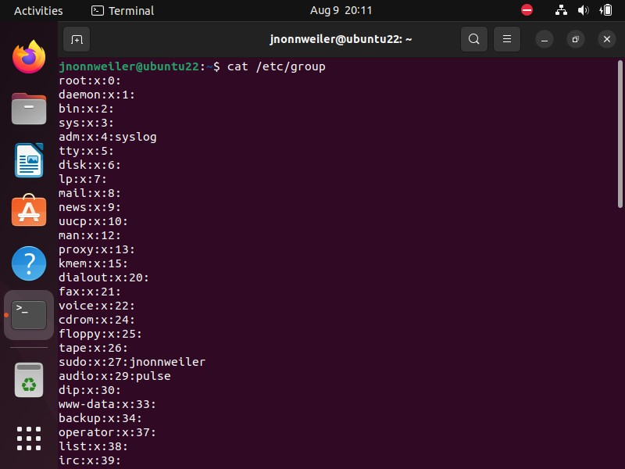
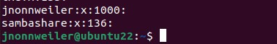
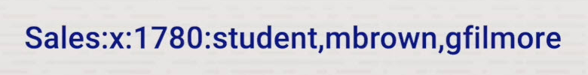
Locally Stored User Account Information
/etc/group → holds the group information
Group name
Group password (an "x" in the field indicates that passwords are stored in the /etc/shadow file)
Group ID (GID)
Group members (contains a comma-separated list of user accounts (members) in the group)
/etc/gshadow holds the password hashes for groups

Slide 12
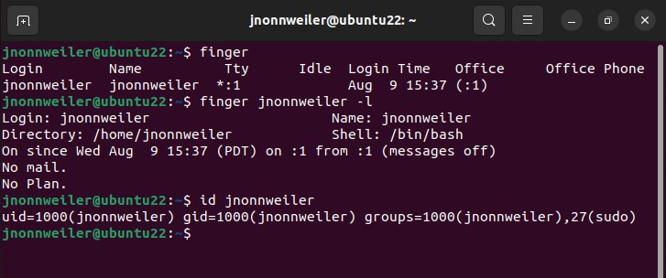
User Account Information
finger → displays information about the users currently logged in to a host
id → used to confirm the identity of a specified Linux user

Slide 13
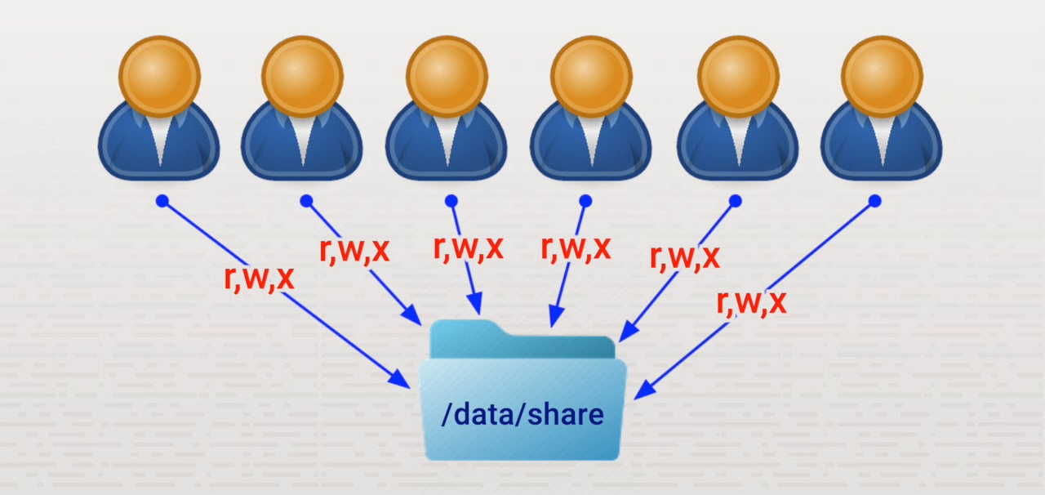
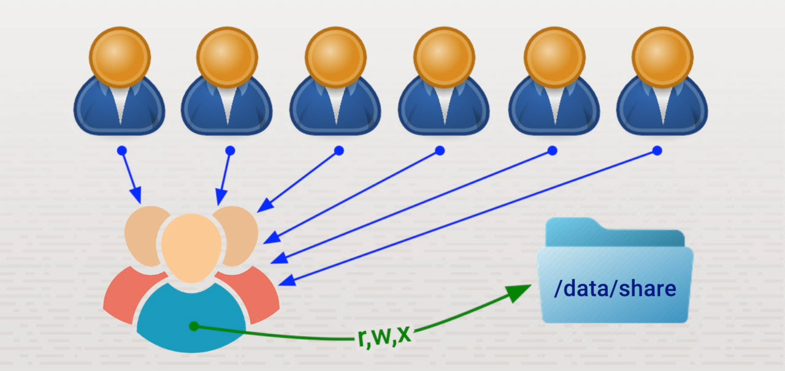
Benefits of Groups

Slide 14
passwd and shadow File Synchronization
passwd and shadow files → must remain in synch
(never) edit these text files… any change can break system/login
Commands to affect passwd / shadow files
pwck
Verifies links Displays errors
pwconv
fixes sync errors → moves/updates passwords to the shadow file

Slide 15
User Management
Add user accounts
Modify user accounts
Delete user accounts
Change passwords

Slide 16
Key Terms/Definitions
Shadow file
A system file where encrypted user passwords are stored.

Slide 17
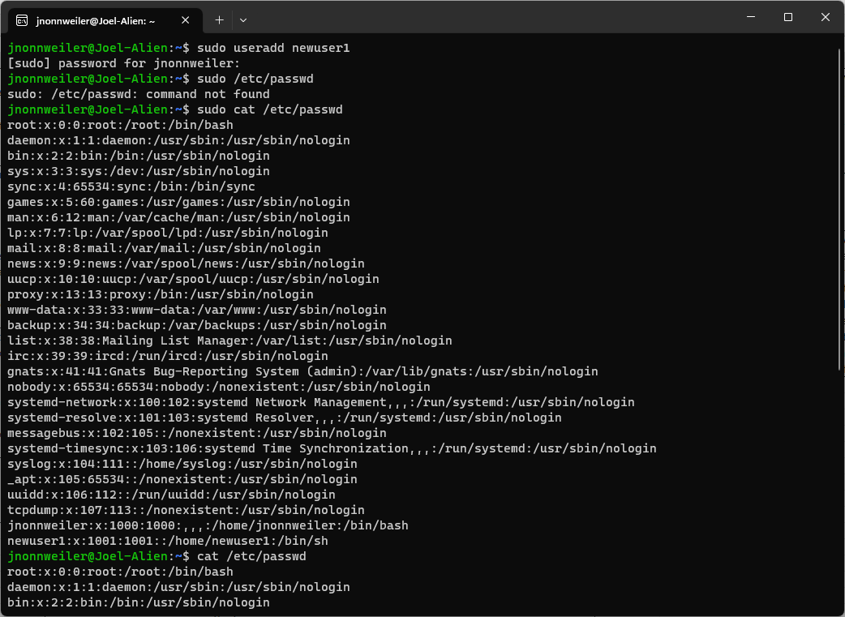
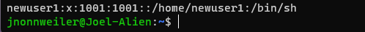
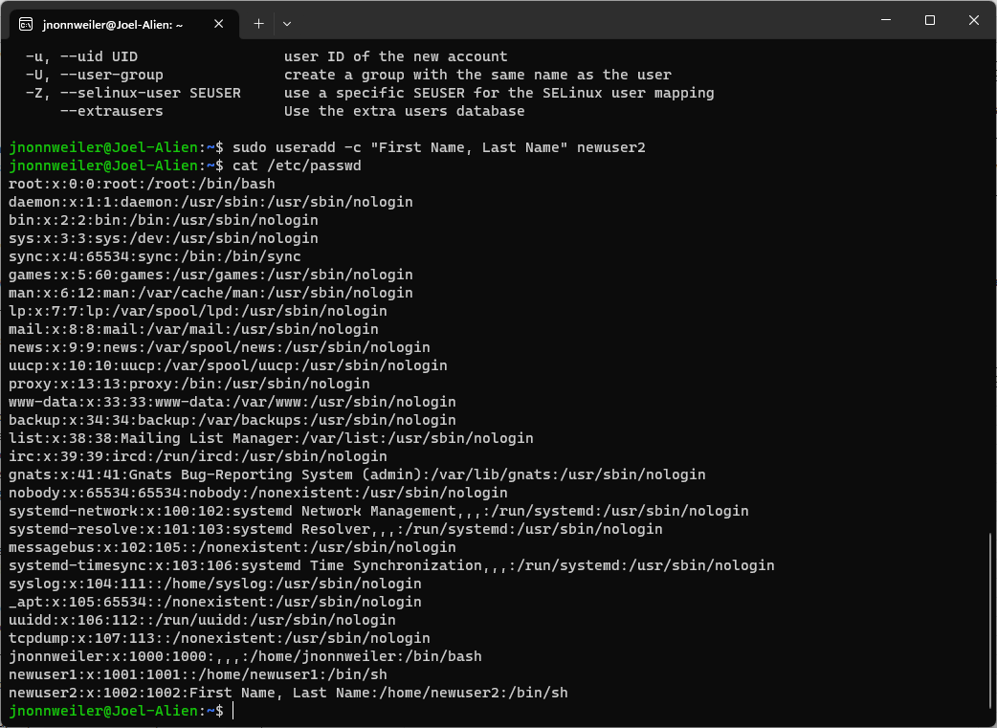
User and Password Management

Slide 18
User and Password Management
This is where you would add directories that you want standard users to have when provisioning the account

Slide 19
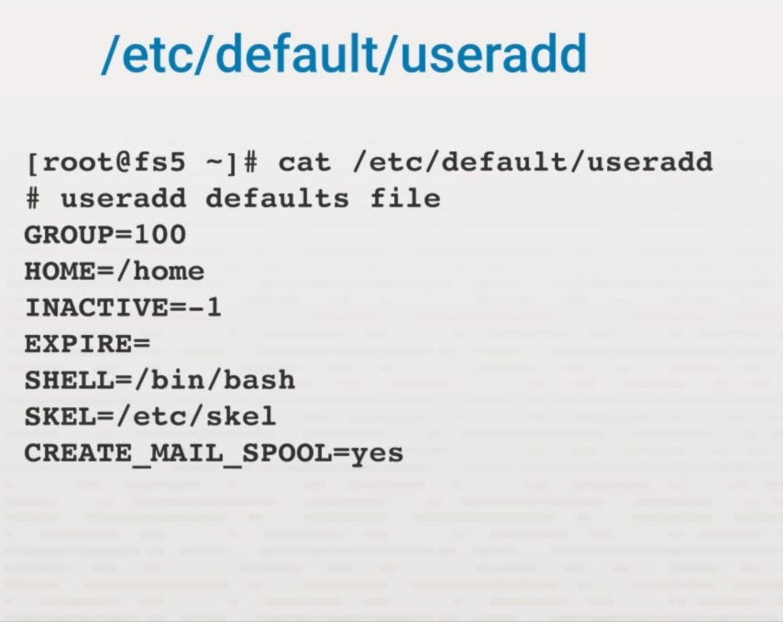
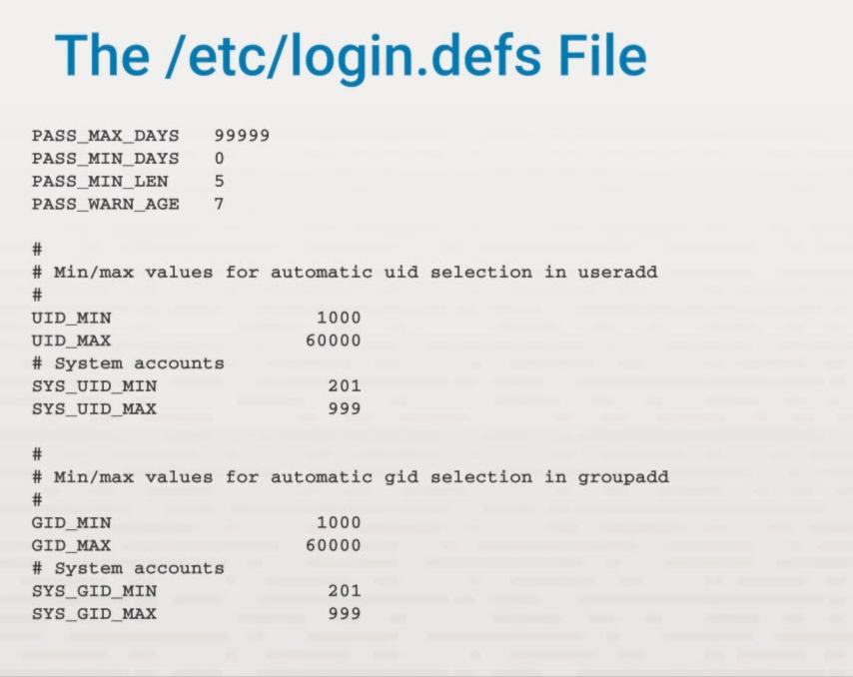
User and Password Management

Slide 20
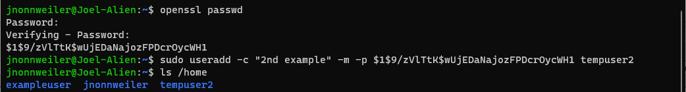
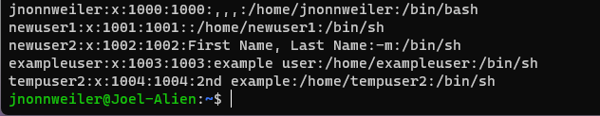
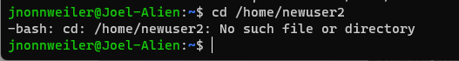
User and Password Management

Slide 21
User and Password Management

Slide 22
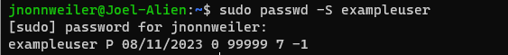
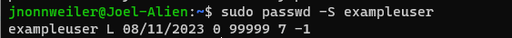
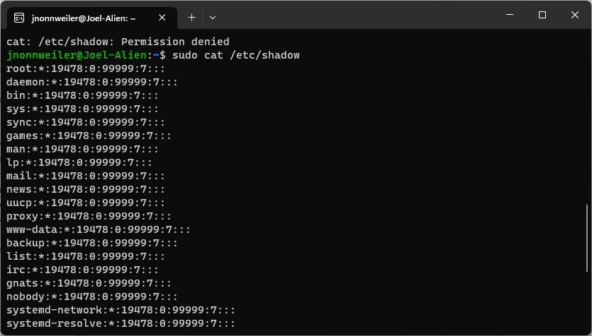
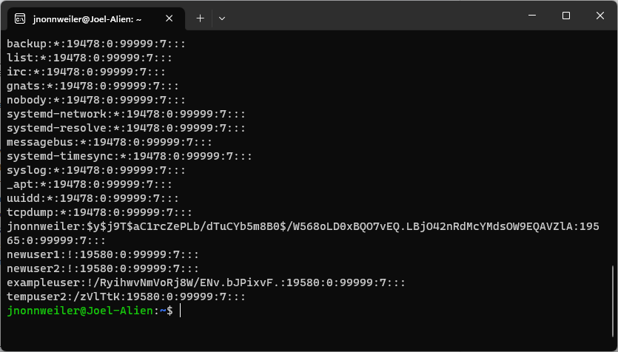
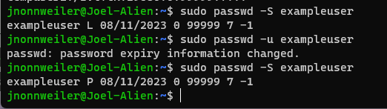
User and Password Management
← Locked exampleuser

Slide 23
User and Password Management

Slide 24
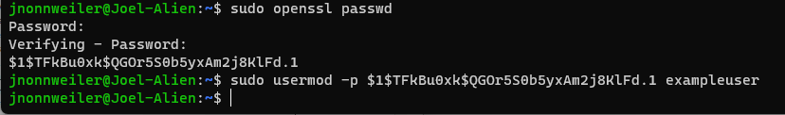
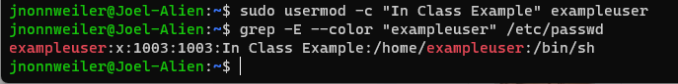
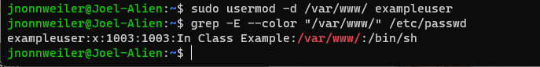
User and Password Management
Good examples…
https://www.tecmint.com/usermod-command-examples/

Slide 25
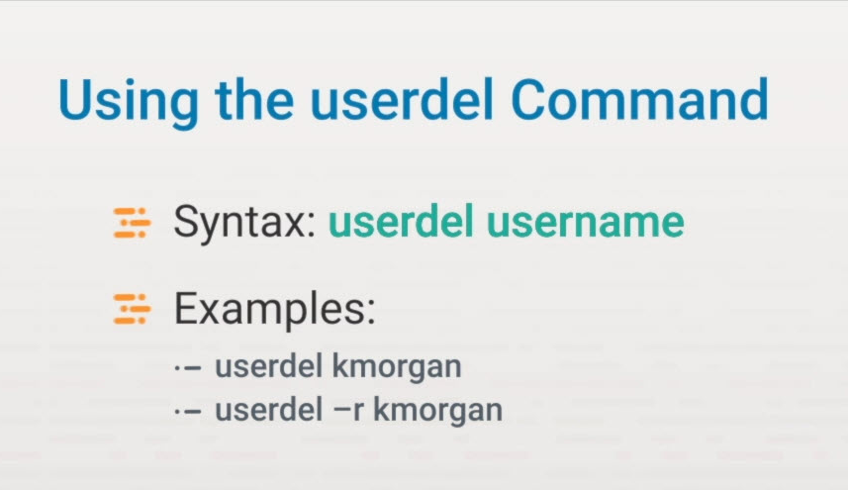
User and Password Management

Slide 26
Group Management
Add groups
Modify groups
Delete groups

Slide 27
Key Terms/Definitions
Group
A collection of users that can be used to help manage users, such as assigning and revoking permissions to files and directories.

Slide 28
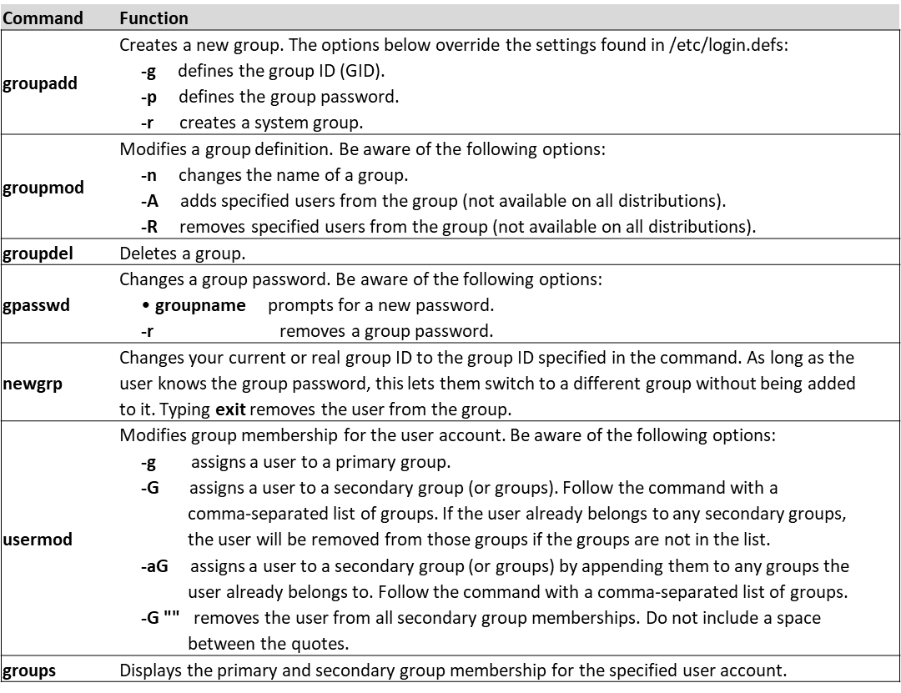
Group Management

Slide 29
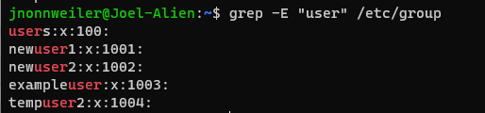
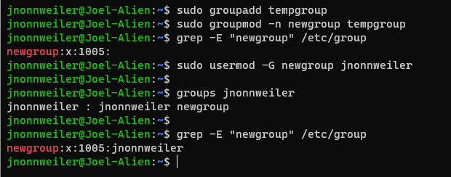
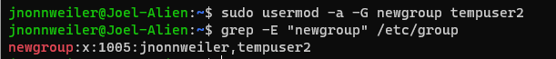
Group Management

Slide 30
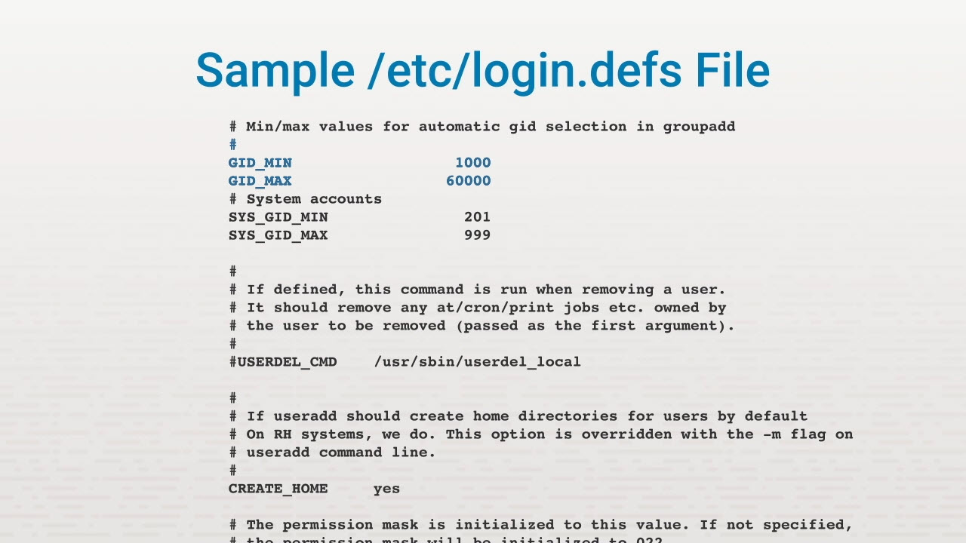
Group Management

Slide 31
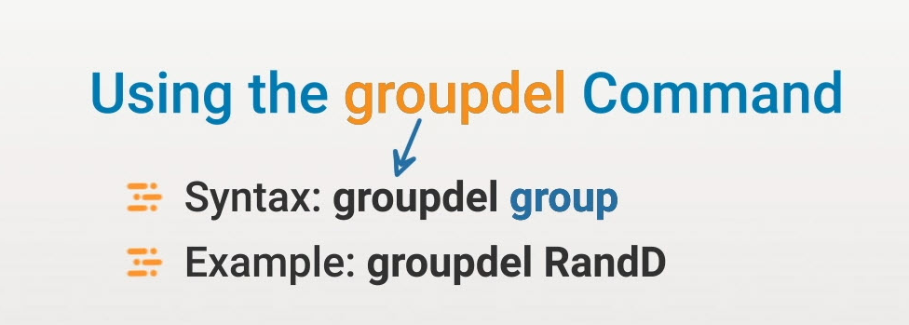
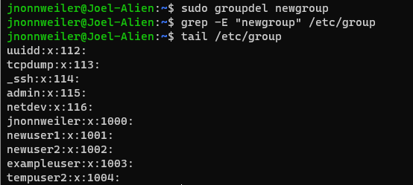
Group Management

Slide 32
Troubleshoot User Issues
User login issues
File access issues
Password issues
Privilege elevation
Quota issues

Slide 33
User Login Issues
Wrong or missing password Caps lock Account expiration Time of day

Slide 34
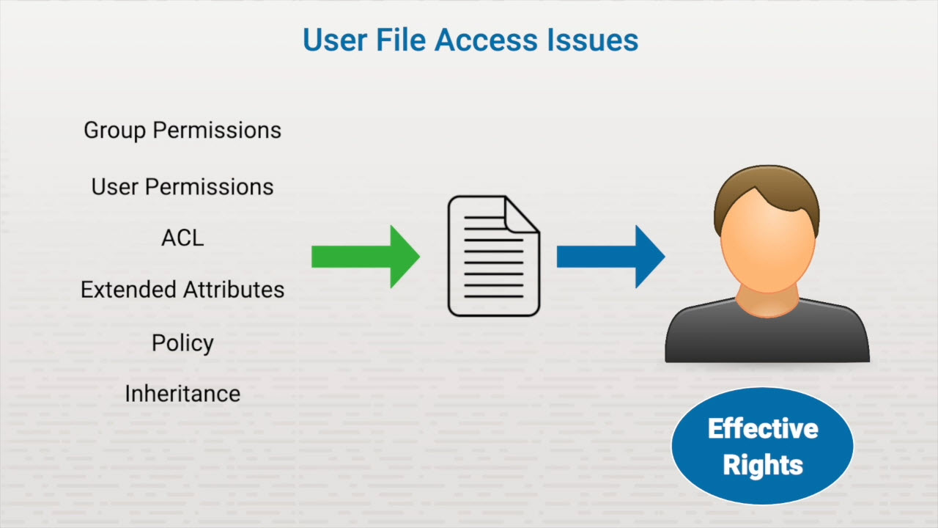
Common User Account Problems

Slide 35
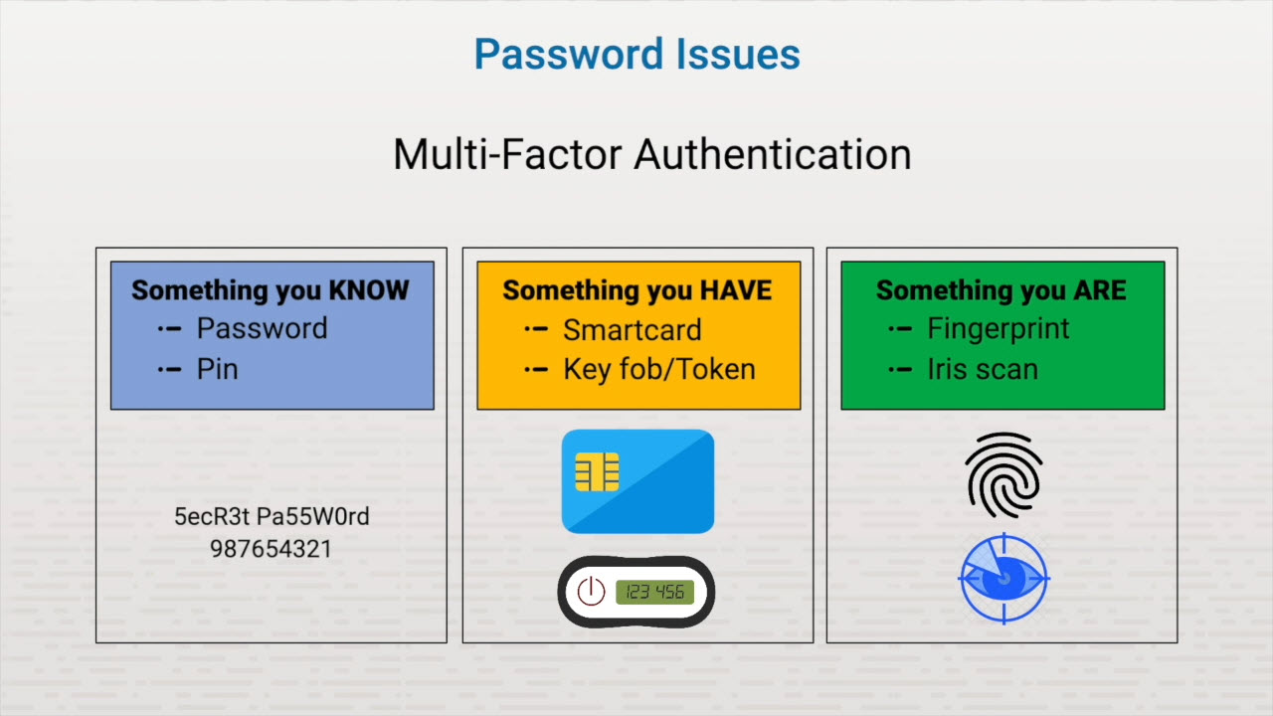
Common User Account Problems

Slide 36
Privilege Elevation
Log in as normal user; elevate permissions to administrative Part of normal Linux operation
Example - changing password
Hackers elevate their own user's privileges Mitigated by digital signatures or encryption Rule of least privilege

Slide 37
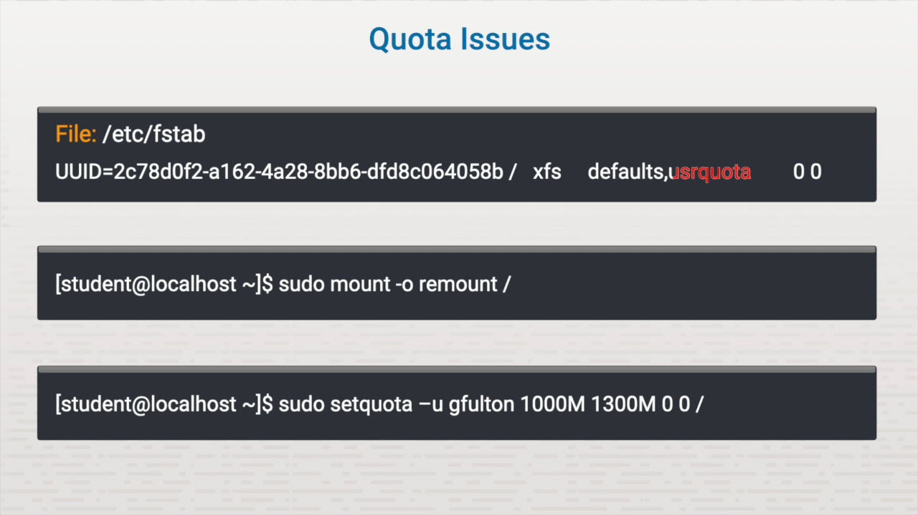
Common User Account Problems

Slide 38
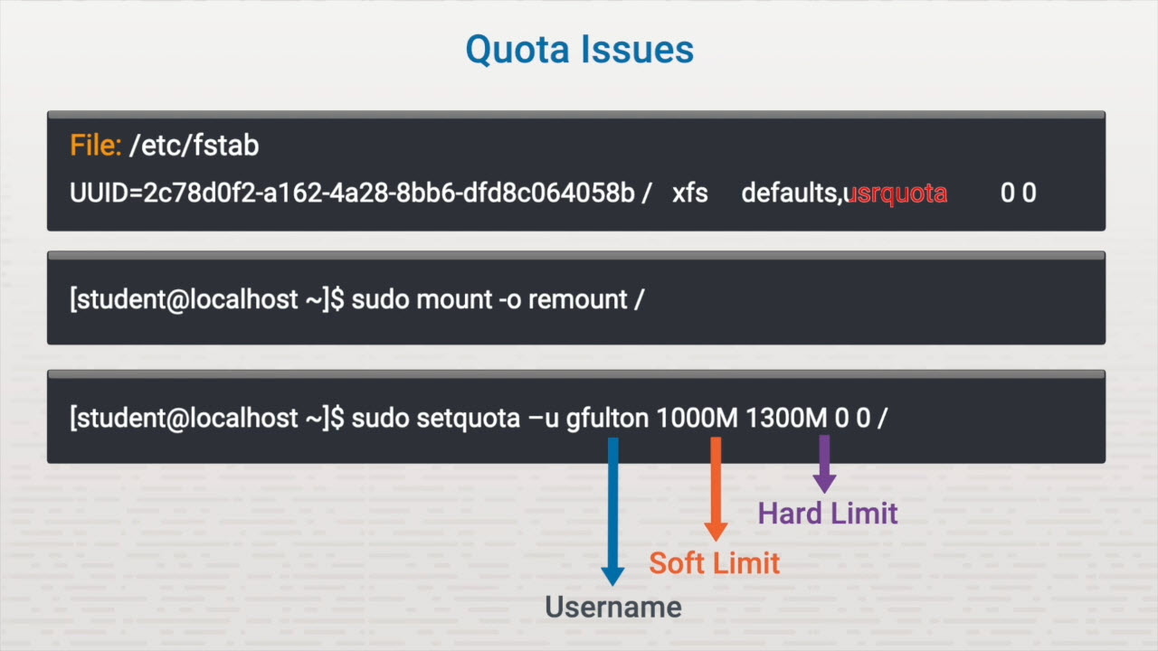
Common User Account Problems

Slide 39
Quota Issues
quota repquota
-a -s
setquota
-t 1 day — 86,400 seconds 7 days — 604,800 seconds

Slide 40
Common Permission Problems
Verify file type
Check existing permissions
Alter permissions
Verify administrative privileges

Slide 41
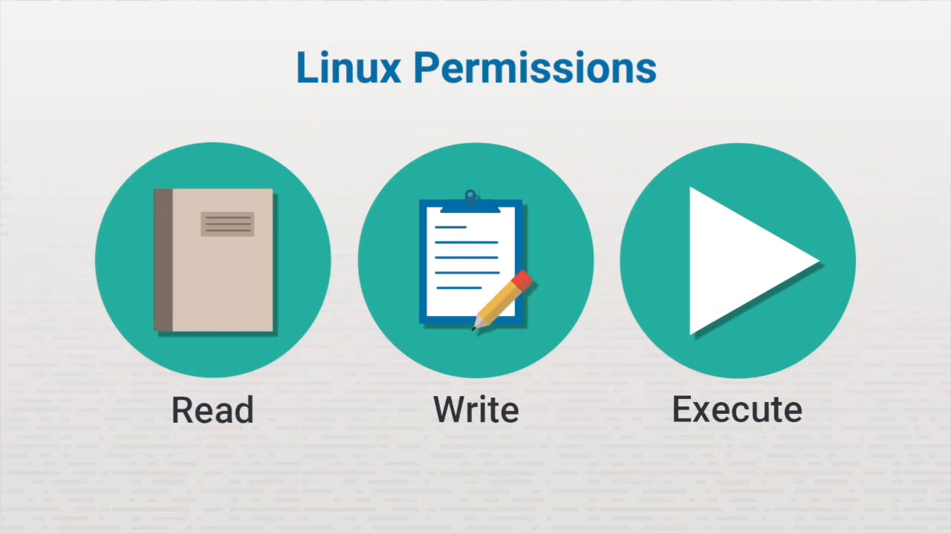
Common Permission Problems

Slide 42
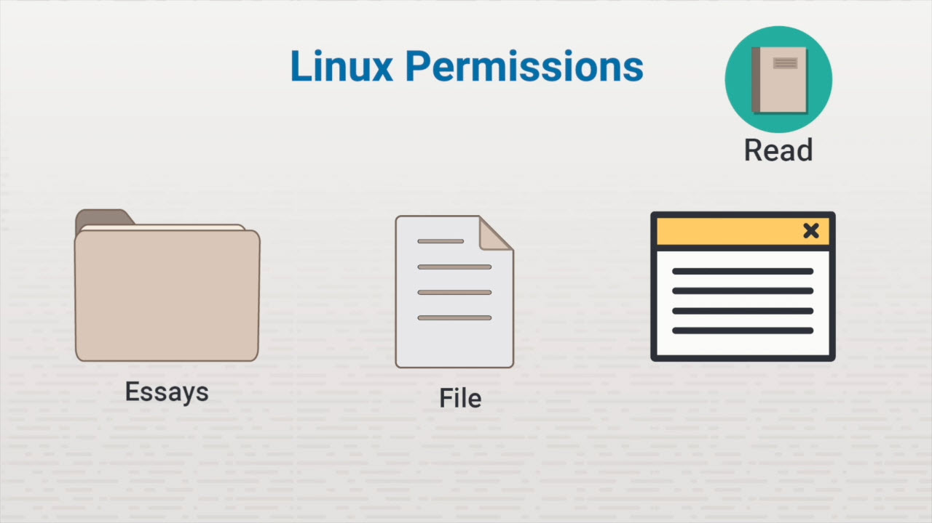
Common Permission Problems

Slide 43
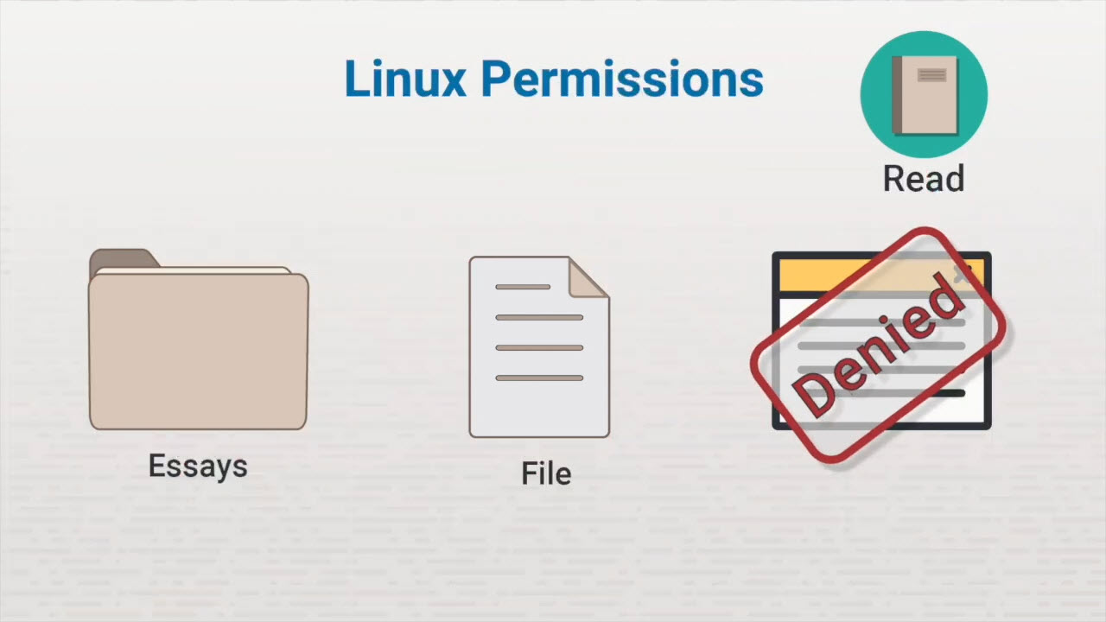
Common Permission Problems

Slide 44
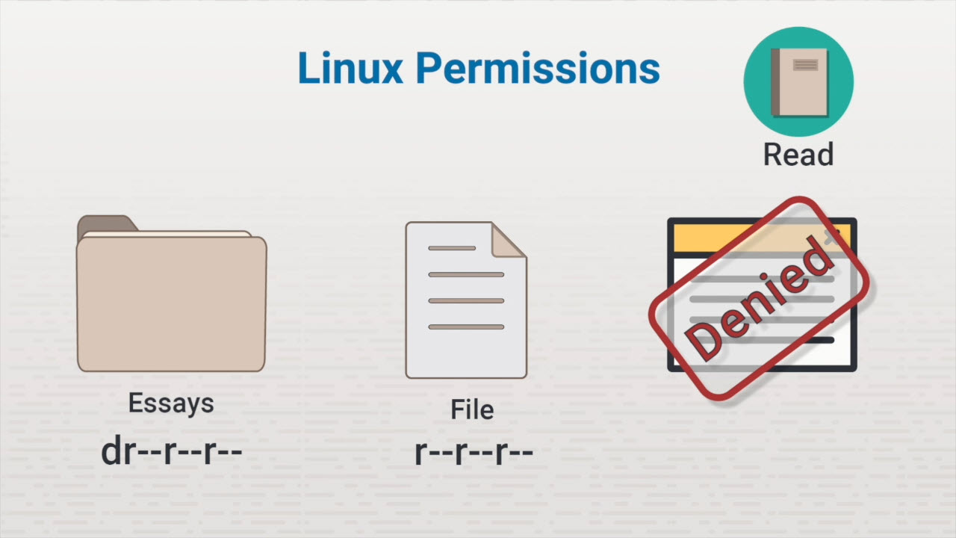
Common Permission Problems

Slide 45
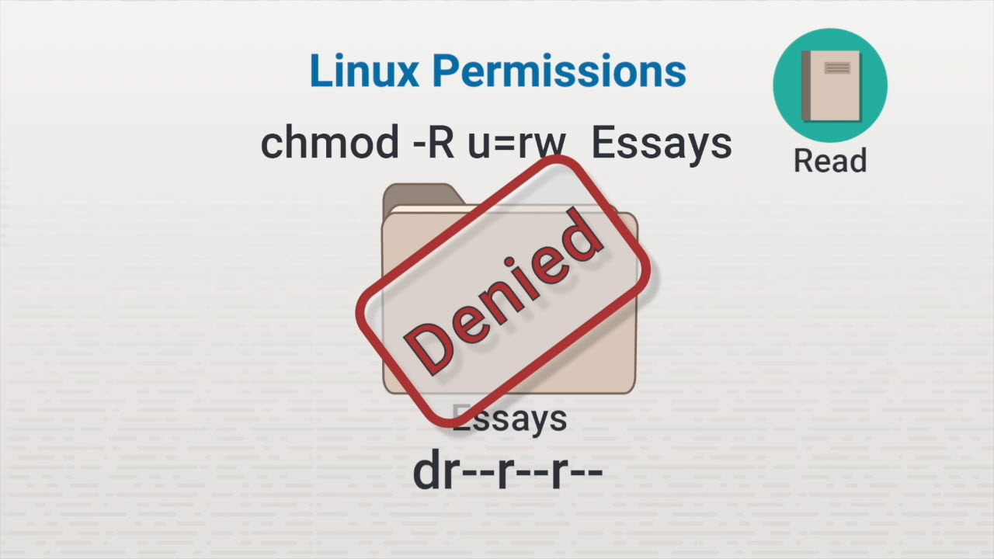
Common Permission Problems

Slide 46
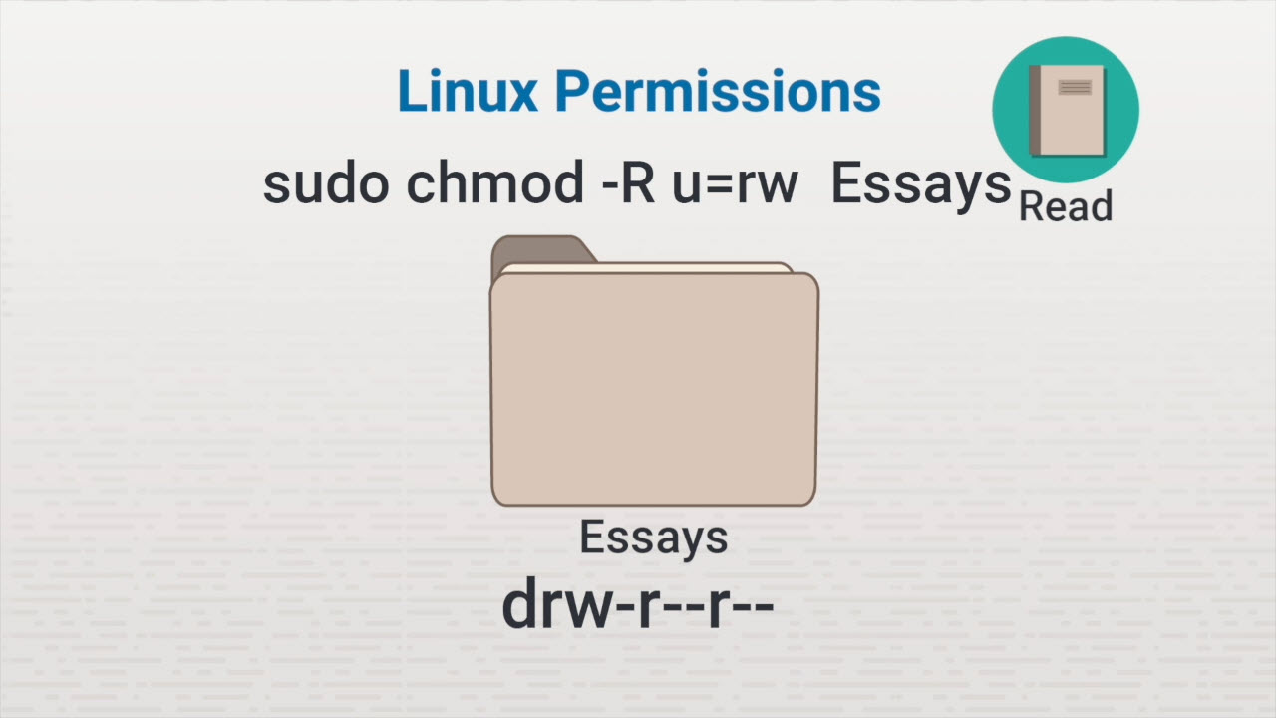
Common Permission Problems

